Slide 1
Daily Writing
Quarter 1

Slide 2
August 11, 2015
“I hope you will have a wonderful year, that you'll dream dangerously and outrageously, that you'll make something that didn't exist before you made it, that you will be loved and that you will be liked, and that you will have people to love and to like in return. And, most importantly (because I think there should be more kindness and more wisdom in the world right now), that you will, when you need to be, be wise, and that you will always be kind.” ― Neil Gaiman

Slide 3
August 12, 2015
Create your own holiday. What would you celebrate? How could you get others to join in the fun?

Slide 4
August 13, 2015
Why should people be honest? What does it mean to be honest?

Slide 5
August 17, 2015
"And now that you don't have to be perfect, you can be good."
- John Steinbeck, East of Eden

Slide 6
August 19, 2015
Pick one:
It’s said that people average thirteen lies a week. What were your last thirteen?
What would you do with I million dollars?
Write your life story in fourteen words exactly. Make it stylish.

Slide 7
August 20, 2015
Where do you see yourself in 10 years?

Slide 8
August 24, 2015
Using concrete details, describe someone that you know. Be creative and specific!

Slide 9
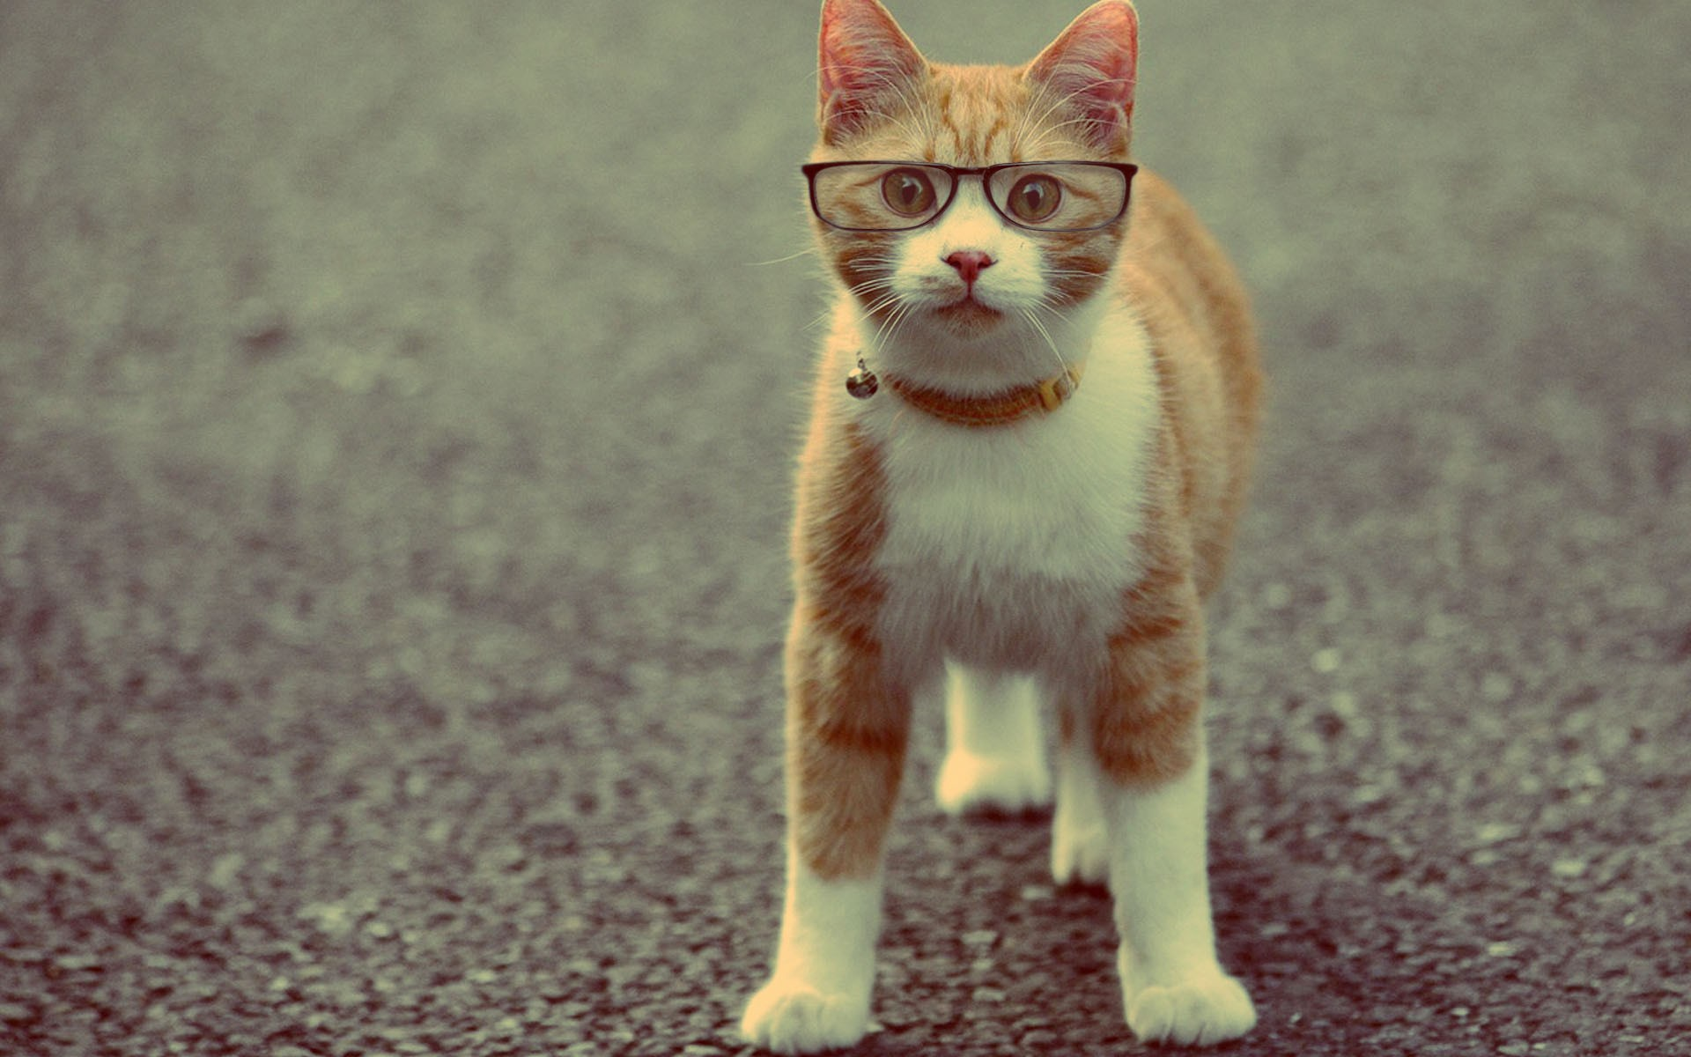
August 25, 2015
Pick one:
1. Using concrete details, describe a fantasy universe (world) where this cat exists.
2. Write a short story (flash fiction) with this cat as the main character.

Slide 10
August 26, 2015
Free Write

Slide 11
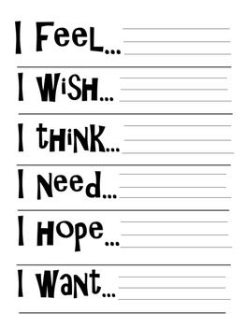
August 27, 2015

Slide 12
August 31, 2015
“Everybody is a genius. But, if you judge a fish by its ability to climb a tree, it will live its whole life believing that it is stupid.” – Einstein

Slide 13
September 1, 2015
Lindsey Sterling, 5 senses writing prompt. If you were absent, free write.

Slide 14
September 2, 2015
“Fairy tales are more than true: not because they tell us that dragons exist, but because they tell us that dragons can be beaten.”
Neil Gaiman, Coraline

Slide 15
September 3, 2015
It's a three day weekend! What are your plans?

Slide 16
September 8, 2015
I write to give myself strength.
I write to be the characters that I am not.
I write to explore all the things I'm afraid of.
- Joss Whedon

Slide 17
September 9, 2015
If you would not be forgotten as soon as you are dead, either write something worth reading or do things worth writing."
Benjamin Franklin

Slide 18
September 10, 2015
The writer's job is to tell the truth. All you have to do is write one true sentence. Write the truest sentence that you know."
Ernest Hemingway

Slide 19
September 14, 2015
Free Write

Slide 20
September 15, 2015
"Writing without revising is the literary equivalent of waltzing gaily out of the house in your underwear." -Patricia Fuller
What part of your story needs the most work (revision)?

Slide 21
September 21, 2015
What is your strategy this week in order to finish the quarter assignments? What do you have left to finish?

